Slide 1

Green Pace
Security Policy Presentation
Developer: Robert Sanford

Slide 2

OVERVIEW: DEFENSE IN DEPTH
This illustration depicts a Security policy that utilizes multiple layers of security measures. The multiple layers act as multiple lines of defense in the event of a cyber-attack, this is known as Defense in Depth. This is important because if a vulnerability is found in one layer, there are several more layers to fall back on and keep the system secure. In the event of a cyber-attack, a hacker must get through all the security measures to breach the system.

Slide 3
THREATS MATRIX
Likely Threats that are likely to occur. | Priority Threat that has high severity and could be expensive to repair.
Low Priority Threat that has low severity and could be inexpensive to repair. | Unlikely Threats that are not likely to occur.

Slide 4
10 PRINCIPLES
Validate Input Data
Heed Compiler Warnings
Architect and Design for Security Policies
Keep It Simple
Default Deny
Adhere to policy of least Privilege
Sanitize Data Sent to Other Systems
Practice Defense in Depth
Use Effective Quality Assurance Techniques
Adopt a Secure Coding Standard

Slide 5
CODING STANDARDS
Data Type - Don’t cast an out-of-range enumeration value as it can cause unexpected behavior.
Data Value - Use valid references, pointers, and iterators to reference elements of a container.
String Correctness - Do not attempt to create a std::string from a null pointer.
SQL Injection - Sanitize data passed to complex subsystems.
Memory Protection - Properly deallocate dynamically allocated resources.
Assertions - Use a static assertion to test the value of a constant expression.
Exceptions - Handle the exceptions thrown before main() begins executing.
Input/Output - Exclude user input from format strings.
Declarations - Do not reuse variable names in subscopes.
Containers - Value returning functions must return a value from all exit paths.

Slide 6
ENCRYPTION POLICIES
Encryption at Rest – Used to protect data that is stored on physical storage devices such as an SSD. Encrypting data on disks prevents attackers from accessing it unless authorized.
Encryption at Flight – Used to protect data that is being transmitted through a network. Most important for entities that transmit data over the internet. Encryption in Flight protects data that is being moved from one place to another.
Encryption in Use - Encryption in use is the process of protecting data as it is utilized in memory. The main way of doing this is by utilizing password protected profiles, as they protect the memory of each user for the data stored in memory for that profile could be used to compromise their data in rest or flight.

Slide 7
TRIPLE-A POLICIES
Authentication - Process is used to prove who a user is by verifying their user id, password, and any other means of verification of that user’s identity. Users must be authenticated at log in before gaining access to the system.
Authorization - Once a user is authenticated, they may be given authorization to various aspects of the system depending on their role and granted permissions. For example, users must have the authorization to add new users to the system.
Accounting - Accounting after authentication and authorization is important to keep track of who does what within the system. This way the activities of all users within the system are documented, such as changes to the database and files accessed by the user

Slide 8
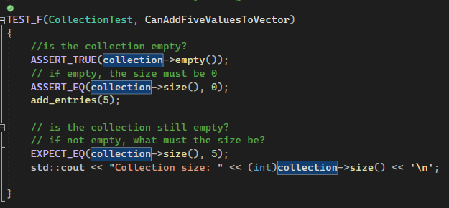
Unit Testing
This unit test is CanAddFiveValuesToVector. It verifies that five values can be added to a collection. This is a positive test.

Slide 9
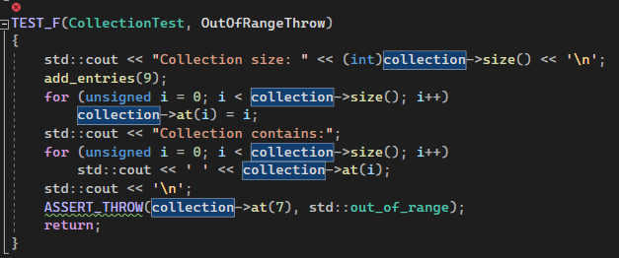
Unit Testing cont.
This test is called OutOfRangeThrow. It tests if an exception is thrown when calling at() with an index out of bounds This is a negative test.

Slide 10
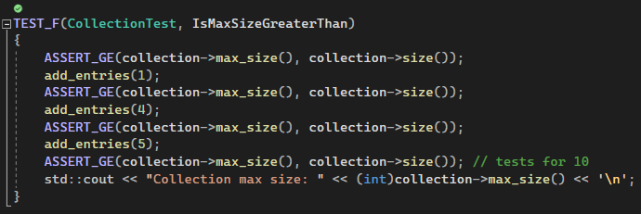
Unit Test cont.
This test is called IsMaxSizeGreaterThan. It tests that that max size is greater than or equal to size for 0, 1, 5, 10 entries. This test is positive.

Slide 11
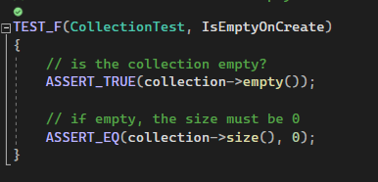
Unit Test cont.
This test is called IsEmptyOnCreate. It tests if a collection is empty when created. This test is positive.

Slide 12

AUTOMATION SUMMARY

Slide 13
TOOLS
The DevSecOps pipeline is a strategy used by Green Pace to implement Defense in Depth and secure policies. This strategy begins with a pre-production phase consisting of planning, designing, building secure code, and verifying and testing the system. The production phase consists of maintaining the program, responding to any threats, monitoring and detecting threats, and transitioning and performing health checks.
Active Directory is used for storing sensitive data and is a secure way to manage policies and network resources.
Lightweight Directory Access Protocol (LDAP) is used to query user information quickly. LDAP controls access and maintenance of static data like usernames, passwords, and email addresses.

Slide 14
RISKS AND BENEFITS
The risk of waiting to implement security policies is greater than the risk of implementing security policies early. By waiting to implement security, time, money and company reputation are all at risk if the system has vulnerabilities when it is ready for production.
It is wise to begin implementing security from the very beginning. In doing so, there is a much higher level of security in the system and the chance of a vulnerability being exploited is much less.

Slide 15
RECOMMENDATIONS
Keep current with all security updates and patches.
Stay consistent with Coding Standards.
Have a contingent plan in place in case of an attack.
Utilize a Defense in Depth approach.

Slide 16
CONCLUSIONS
In conclusion, standards that should be adopted to best ensure an acceptable of cyber security are:
Implementing security from the very beginning of a project.
Utilize multiple layers of security to create a Defense in Depth approach.
Utilize Triple-A architecture to assist with discovering data breaches.
Encrypt all sensitive data in all states, at rest, in flight, and in use.

Slide 17
REFERENCES
Seacord, R. C. (2013). Secure Coding in C and C++ (2nd ed.). Pearson Technology Group. https://mbsdirect.vitalsource.com/books/9780132981972
2 Rules - SEI CERT C++ Coding Standard - Confluence. (n.d.). Wiki.sei.cmu.edu. Retrieved April 23, 2023, from https://wiki.sei.cmu.edu/confluence/display/cplusplus/2+Rules
‌

